Slide 1
Confessions of a Carless Commuter
What 40,000+ Motorless Miles Taught Me About Life

Slide 2
Have you ever had anything good come from a bad situation?
My story starts with two difficult circumstances that opened up all sorts of unexpected opportunities

Slide 3
No Cutting Corners Where do I want my efforts to lead?
ENTER PICTURE
When you hear the phrase “no cutting corners”, which words or ideas immediately come to mind?

Slide 4
“Therefore you shall be perfect, as your heavenly Father is perfect.” Matthew 5:48
For the longest time, I often found this bible verse intimidating and unrealistic
Ironically, though, it is secular research on perfectionism which compelled me to look at it in a different way

Slide 5
Arbitrary Limits Am I setting limits for myself that are keeping me from being who I am called to be?
Again, when you think of limit-setting, what immediately comes to mind? How do we know if a limit is a productive one or a restricting one?

Slide 6
I can do all things through Him who strengthens me Philippians 4:13
Yet, there are common factors that get in the way of this everyday that result in us setting limits, thus preventing us from being who God calls us to be
What are 3 of the most common factors?

Slide 7
Virtuous living is grounded in exceeding arbitrary limits for ourselves
Courage, temperance, hope, love and so on require us to constantly exceed what we think is possible, often in difficult situations
Consider the story of Viktor Frankl
Consider the story of Nelson Mandela
Consider the story of St. Peter
All of them exceeded arbitrary limits for themselves…

Slide 8
Field of Vision Just how much am I striving to see a full, even if uncomfortable, vision of reality?
The ultimate question isn’t whether we do what is justified, or even what we are supposed to do; rather, it is whether it is the most effective

Slide 9
The problem is that we humans are prone to a number of common biases
Confirmatory Bias
Fundamental Attribution Error
Availability Heuristic
and many more
In order to see a fuller vision, we must be aware of these biases and seek out ways to counteract them

Slide 10
Pride is the biggest deterrent to seeing a fuller vision
Curiosity and humility are the biggest assets in doing so
Opening ourselves to this complete vision means opening ourselves to feedback from all sorts, including those that we know and love, and maybe even despise. It’s a humbling process, and frankly one that you and I might be tempted to avoid…[yet] the fuller our vision is, the less blindsided we will be, and the wiser we will become

Slide 11
If a core message of Jesus’s teaching is to pursue the Truth in Him, and in this world, then we must humble ourselves to see things as they are, not just how we want them to be

Slide 12
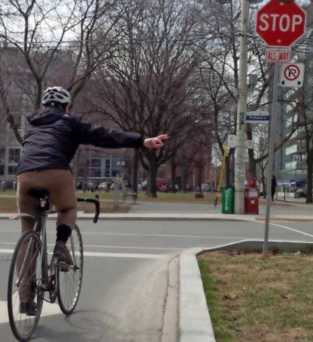
Communication, Communication, Communication How effective and empathetic is my communication?
The single biggest problem with communication is the illusion that it has taken place?
George Bernard Shaw

Slide 13
We are social beings even before we are born
Patterns of communication start even before a baby leaves the womb
Even before a child ever says a word, consider just all the ways that he or she communicates with great effectiveness

Slide 14
4 Hallmarks of Effective Communication
Regardless of personality or disposition (e.g., introverted or extraverted), there are 4 keys to effective communication
Say what you mean. Hyperbole and minimization might work for storytelling, but they are awful for relationships
Always understand that each of us owns our emotions and no matter what has occurred, another individual is not responsible for how we feel (e.g., I vs. You statements)
Always work to focus your criticism on a situation, not a person. It’s natural that we see trends and patterns in our loved ones, but starting with this type of critique (e.g., you are a slob) is rarely an effective way to facilitate conversation and change
Strive to be transparent and honest. If you make a mistake, own it; if something works out, acknowledge that, too. Both a lack of accountability and false modesty are not effective ways to communicate and develop good relationships

Slide 15
4 Horseman of Relationships
Criticism
Stonewalling
Defensiveness
Contempt
John Gottman
Most of us are guilty of these at some point, but the more we engage in them, the worse our communication and relationships become

Slide 16
4 Key Questions to Frame Effective Communication
What is my intent?
What is the simplest, clearest way I can communicate what I am trying to say?
How can I make this interaction, even if it is difficult one, as enjoyable as possible?
What can I do to preserve the safety and sanctity of the person involved?

Slide 17
The woman at the well
Just consider how Jesus’s style of communication in this example overlays these principles in this famous bible story. So often we focus only on the content of his communication, but it seems we should focus just as much on his style of communicating
A Samaritan woman came to draw water, and Jesus said to her, "Give me a drink." (His disciples had gone to the city to buy food.) The Samaritan woman said to him, "How is it that you, a Jew, ask a drink of me, a woman of Samaria?" (Jews do not share things in common with Samaritans.) Jesus answered her, "If you knew the gift of God, and who it is that is saying to you, 'Give me a drink', you would have asked him, and he would have given you living water." The woman said to him, "Sir, you have no bucket, and the well is deep. Where do you get that living water? Are you greater than our ancestor Jacob, who gave us the well, and with his sons and his flocks drank from it?" Jesus said to her, "Everyone who drinks of this water will be thirsty again, but those who drink of the water that I will give them will never be thirsty. The water that I will give will become in them a spring of water gushing up to eternal life." The woman said to him, "Sir, give me this water, so that I may never be thirsty or have to keep coming here to draw water.“
Jesus said to her, "Go, call your husband, and come back." The woman answered him, "I have no husband." Jesus said to her, "You are right in saying, 'I have no husband'; for you have had five husbands, and the man you are now living with is not your husband. What you have said is true!" The woman said to him, "Sir, I see that you are a prophet. Our ancestors worshipped on this mountain, but you say that the place where people must worship is in Jerusalem." Jesus said to her, "Woman, believe me, the hour is coming when you will worship the Father neither on this mountain nor in Jerusalem. You worship what you do not know; we worship what we know, for salvation is from the Jews. But the hour is coming, and is now here, when the true worshippers will worship the Father in spirit and truth, for the Father seeks such as these to worship him. God is spirit, and those who worship him must worship in spirit and truth." The woman said to him, "I know that Messiah is coming" (who is called Christ). "When he comes, he will proclaim all things to us." Jesus said to her, "I am he, the one who is speaking to you."

Slide 18
Time & Space How do I intentionally carve out psychological time & space each day?
Time is what we want most, but we use worst
William Penn
What is the biggest unnecessary distraction in your life?

Slide 19
“I just don’t have the time”
We are all busy people. But very often this lamentation is either an excuse to get out of something we don’t want to do, or a statement regarding our psychological time and space, not time itself.
Consider that the average adult checks his or her phone 150 times a day
Consider that the average American watches 5 hours of TV/internet per day
Consider that the average American spends over 2 hours on social media per day
We actually have way more time than we realize, but what we lack the most is the psychological time & space to allow for clarity of mind that provides for the greatest opportunities for growth, meaning, and joy

Slide 20
And do not be conformed to this world, but be transformed by the renewing of your mind, so that you may prove what the will of God is, that which is good and acceptable and perfect. Romans 12:2
Yet if we do not give our mind the psychological time & space to renew and listen to God, we will never be able to pursue what is good, acceptable, and perfect
There are 3 culprits which prevent our mind from renewing through regular psychological time & space. Any idea what they are?

Slide 21
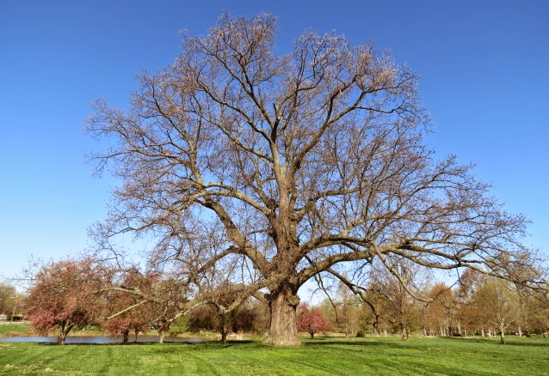
In the mundane, nothing is sacred; In sacredness, nothing is mundane Eihei Dogen
If God created all that we are, and all that surrounds us, then everything we do and all that we are which aligns with His creation is sacred, even what we perceive as the most mundane of all.

Slide 22
There is so much more I learned about life from my carless commuting
Head On
Spared Again
A Ride for All Seasons
Mysterious Forces
Everyday

Slide 23
And yet, in the end, the most important lesson I learned is also one of the most important lessons of Catholicism
But, as lessons, often come from unlikely places, this one involved…
Oatmeal
1:33
Deer flying over my head
Google
A Lauren Daigle tune, and…
A beautiful, desert canyon

Slide 24
Confessions of a Carless Commuter
What 40,000+ Motorless Miles Taught Me About Life

